Slide 1



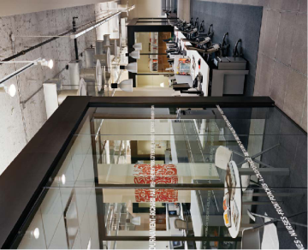


C team
- Jim, Cho, Tom, Lina, Missy
2 Week presentation
Qualcomm Institute

Slide 2
2 week presentation
CONTENTS
C team
Sequence
Diagram
ER
Diagram
Web
Client
Application
Qualcomm Institute

Slide 3
Sequence Diagram
C team
Qualcomm Institute
Notes:
지난 발표에 해서 change point에 대해서

Slide 4
Change point of Sequence Diagram
C team
Delete duplicate information
Change authentication method in forgotten password situation
Change expression
Notes:
비밀번호 변경 방법이 이메일 인증에서 인증 코드로 바뀜
영어 표현 변경
중복 설명 제거
어떻게 변했는지 확인해 보자 (인증 코드 사용하는것으로 바꼈다)

Slide 5
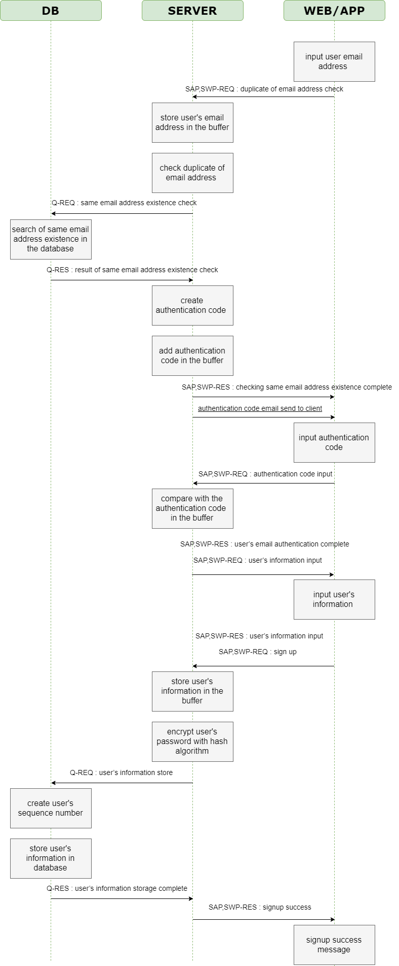
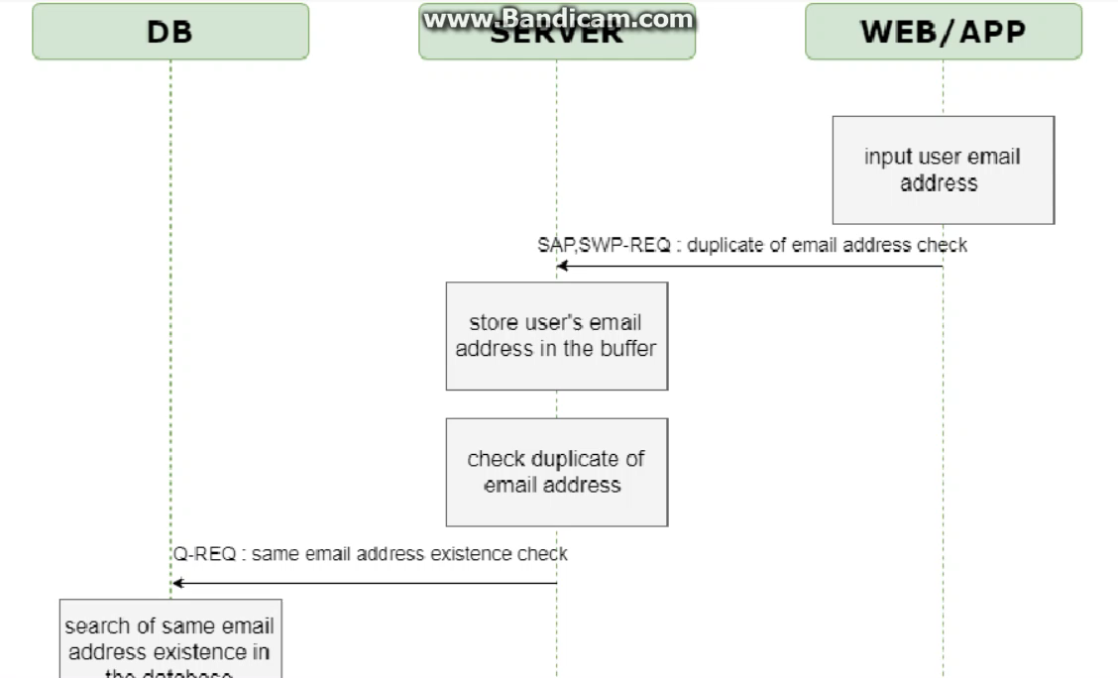
Registration Sequence Diagram
C team

Slide 6
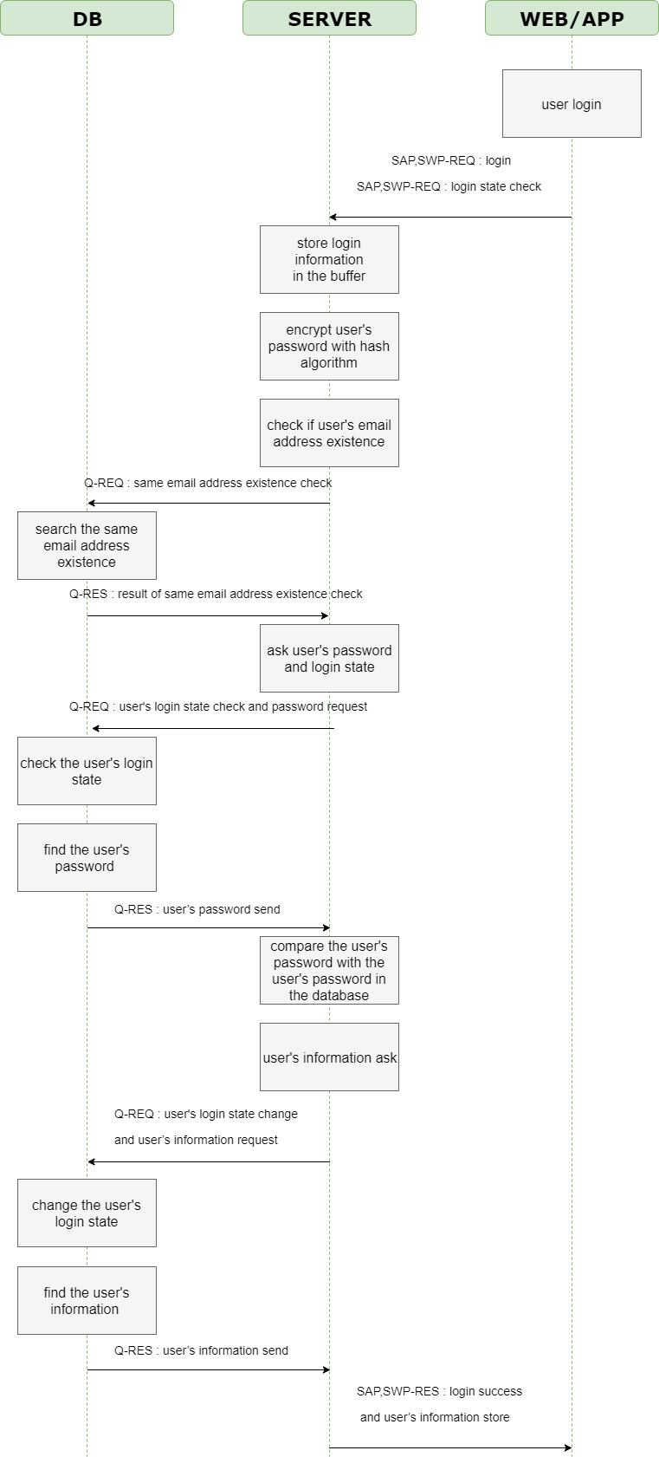
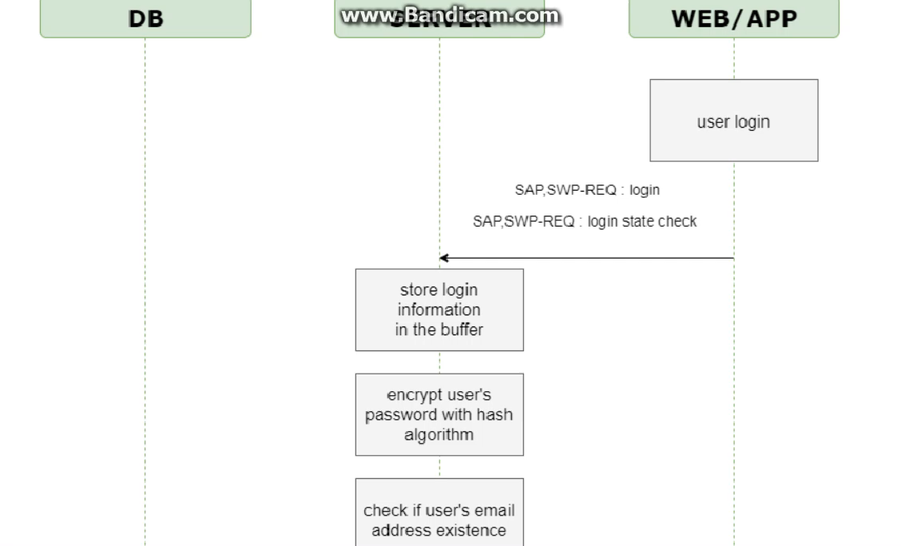
Sign-in Sequence Diagram
C team

Slide 7
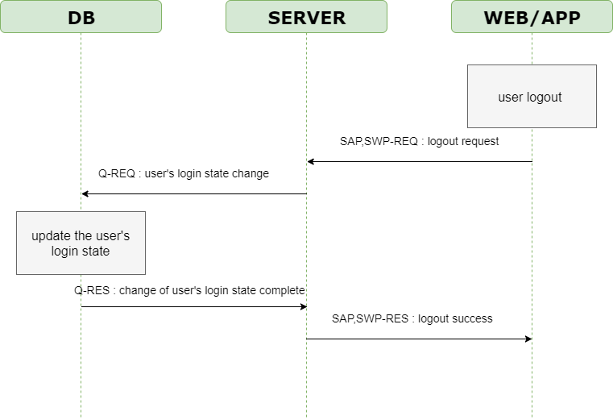
Sign-out Sequence Diagram
C team

Slide 8
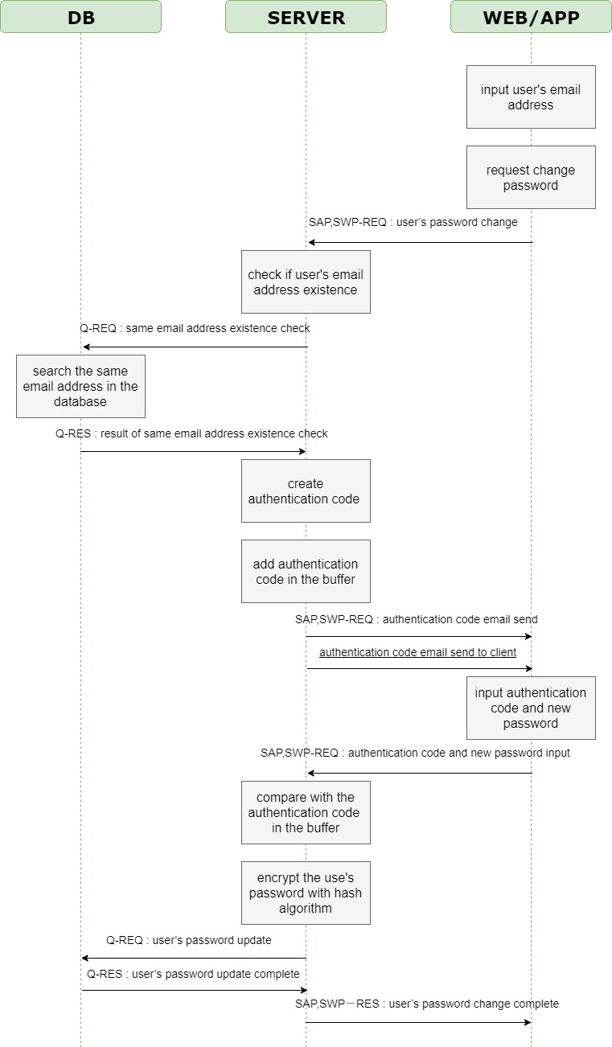
Forgotten password Sequence Diagram
C team
Notes:
- There are not many changes. It is similar to last meeting.

Slide 9
ER Diagram
C team
Qualcomm Institute

Slide 10
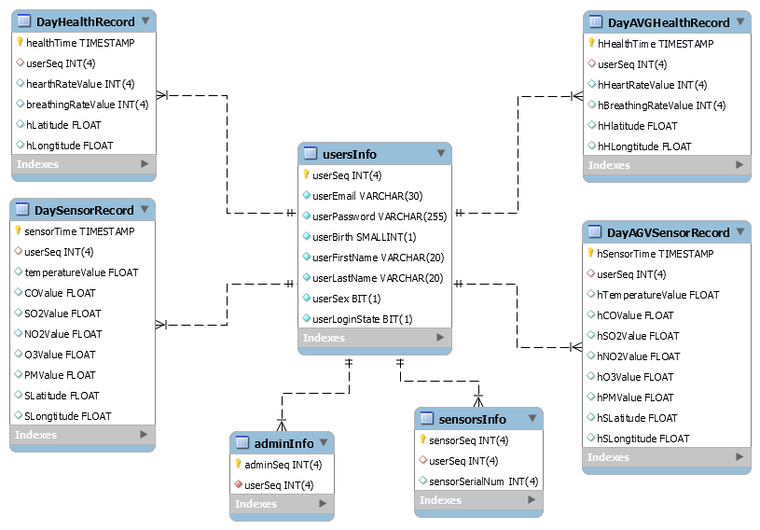
ER Diagram
C team
Notes:
To prevent duplicate logins
After a day, we will average this record and save it.
This table has an average daily record.

Slide 11
Web Client
C team
Qualcomm Institute

Slide 12
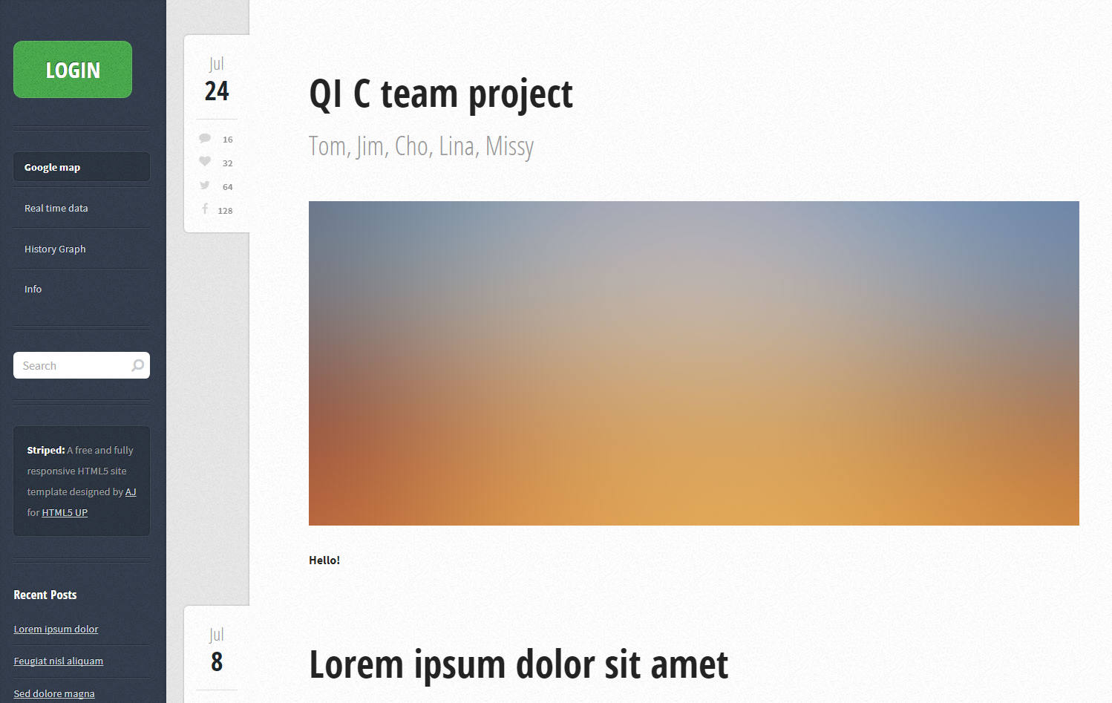
Web client - template
C team
Notes:
- You can see easy at a glance

Slide 13
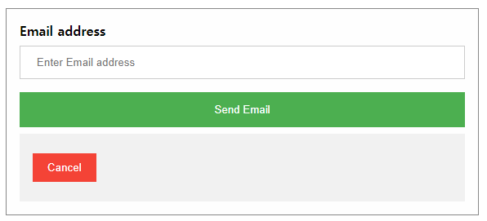
Web client – function(1) Sign up
C team
Before input the user’s information
Notes:
- we have not done it yet

Slide 14
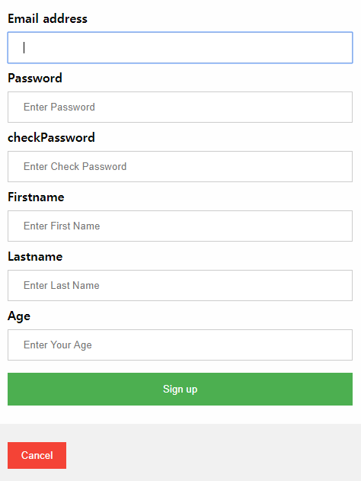
Web client – function(1) Sign up
C team
Encrypt with hash algorithm
Check password
Notes:
If the two are different, a message says the wrong password.

Slide 15
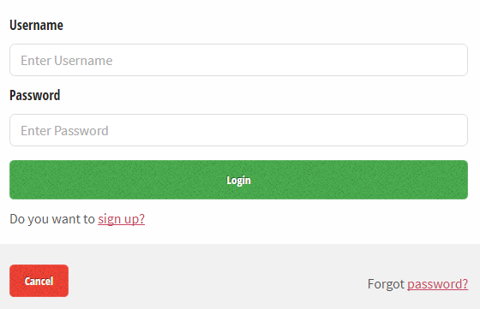
Web client – function(2) Login
C team
- Check correct password
Notes:
- Let's see how it works

Slide 16
Web client
C team
Web Client
Notes:
- Let's see how it works

Slide 17
Application UI
C team
Qualcomm Institute

Slide 18
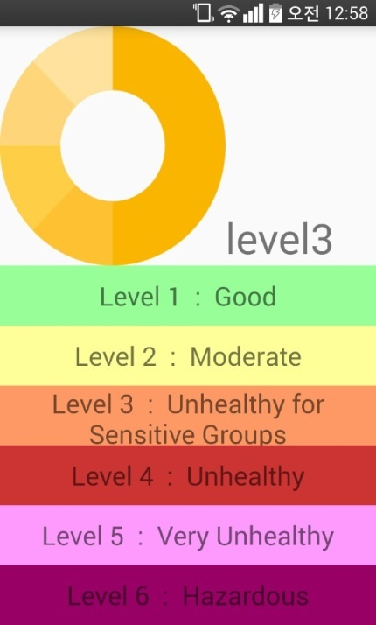
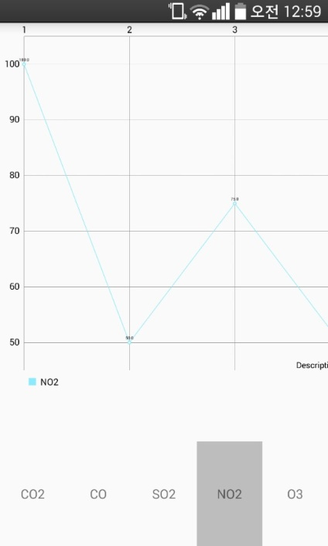
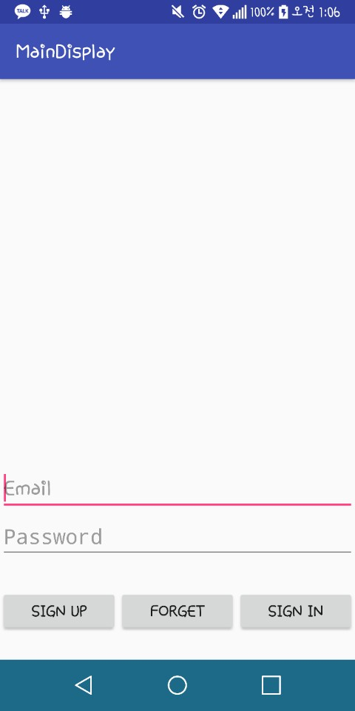
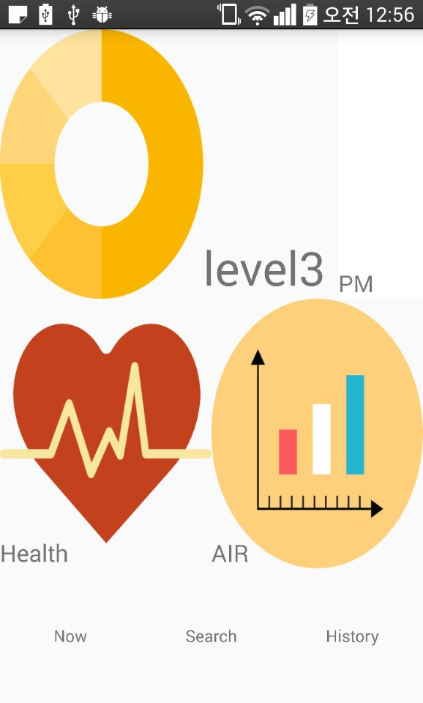
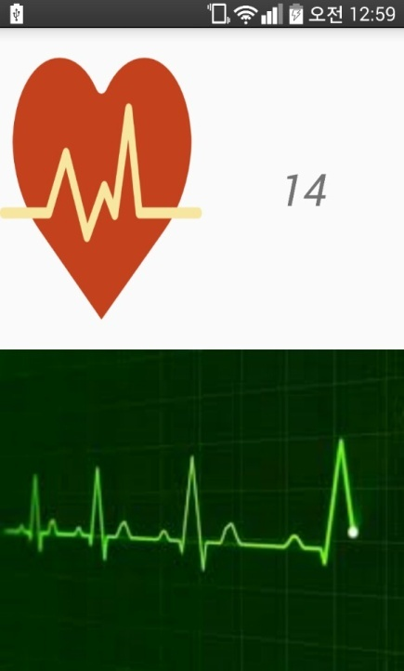
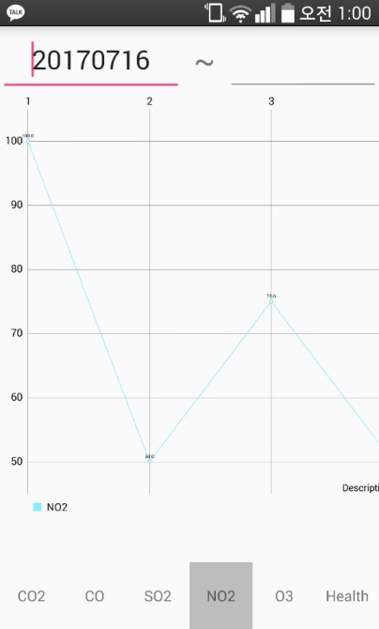
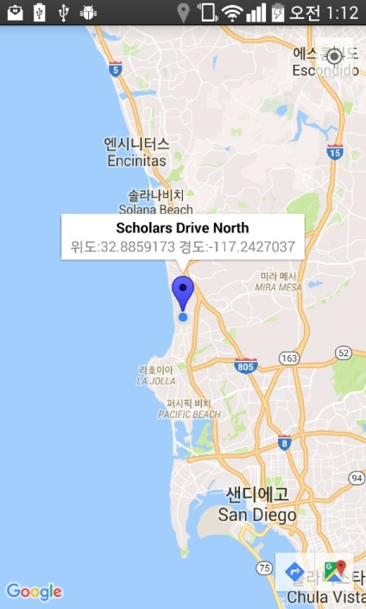
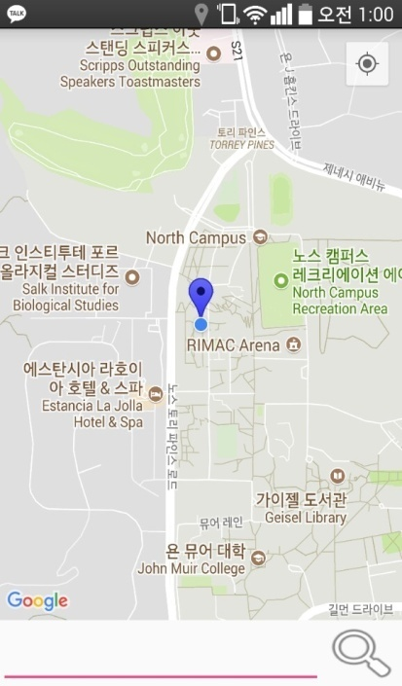
Application UI
C team

Slide 19
Application Activity Function
C team
Sign-Up
1. Confirm duplicate of user’s email
2. Certificate user’s email
3. Reconfirm Password
4. Give Unique Sequence number
5. Information about User
- Name(First, Last), Birth, Gender, E-mail, PW
6. Select notification Service

Slide 20
Application Activity Function
C team
Sign-In
Change email to Sequence number
Reset the passwords
Find Email
Graph
Health
Home Activity
1. Show the heart rate graph
2. Display the breathing rate per minute

Slide 21
Application Activity Function
C team
Map
1. Display current position on google map
2. Display the real-time air density
3. Search the location on google map
Air Density
Graphing & Display the real-time air density
Figure the AQI value (Pie Graph)
Display history of sensor data by date

Slide 22
Thank you
Qualcomm Institute

